Slide 1
Drone Phenology Monitoring
Gaurav Rajput
Parth Thakur

Slide 2
Objective
Tracking individual tree crowns across multiple drone orthomosaics (time points) using a graph-based approach
Temporal monitoring of trees, including handling complex events such as splits, merges, appearances, disappearances, and ambiguous cases

Slide 3
Blocker: Ubuntu on Workstation
To connect our system with the workstation, we use SSH. For SSH to work, the Ubuntu app on the workstation must be running. Additionally, we need to configure the port and establish the connection via the terminal. However, for the past week, the Ubuntu app hasn't been starting at all. Although it did start temporarily once, it's no longer working not even temporarily. To resolve this issue, Raman Sir’s intervention is required, he is also trying to correct this issue but he has not got any success yet.

Slide 4
Major Cases
1-to-1 match: A tree is detected in both orthomosaics.
1-to-many split: A tree is detected as one in the first, but as two (or more) in the second.
Many-to-1 merge: Two (or more) trees in the first are detected as one in the second.
Disappear: A tree is present in the first, but not detected in the second.
Appear: A new tree appears in the second, not present in the first.
Ambiguous/overlapping: Multiple possible matches

Slide 5
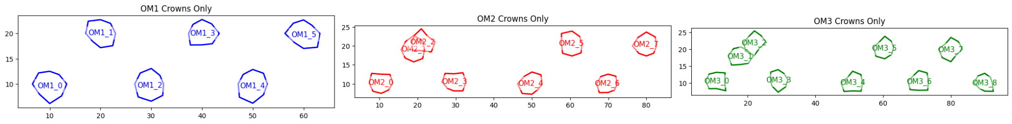
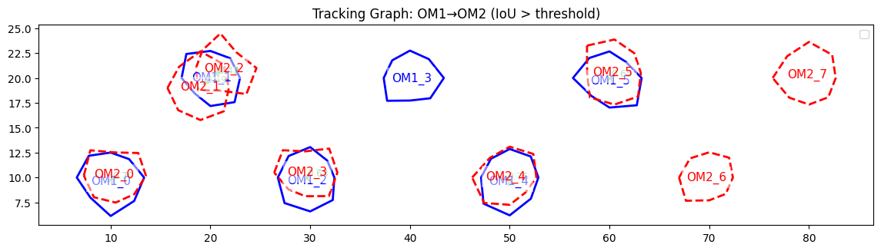
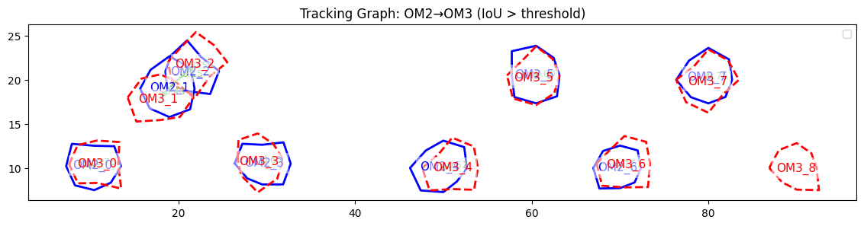
Smaller simulation

Slide 6
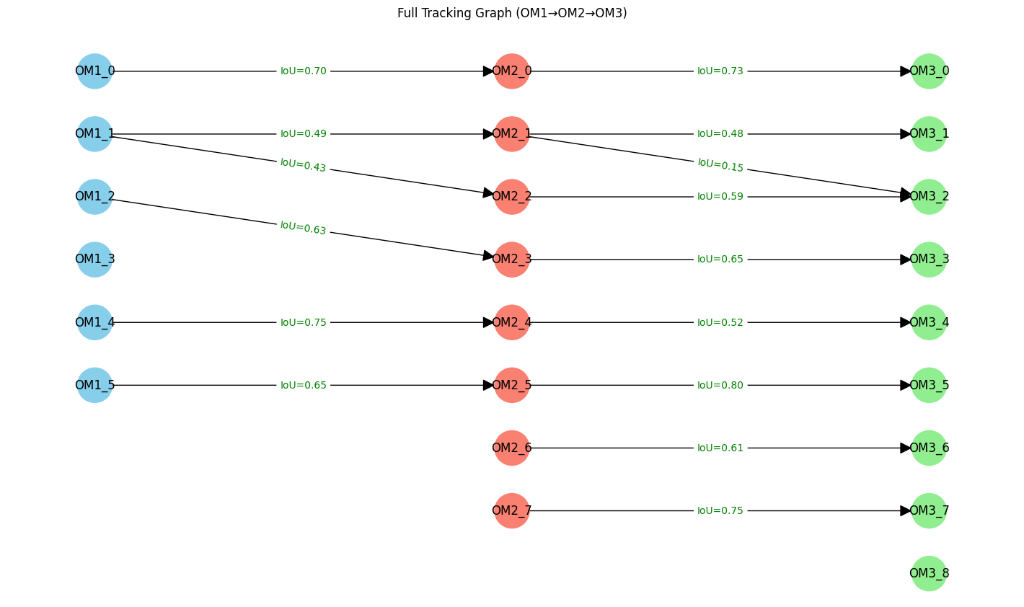

Slide 7
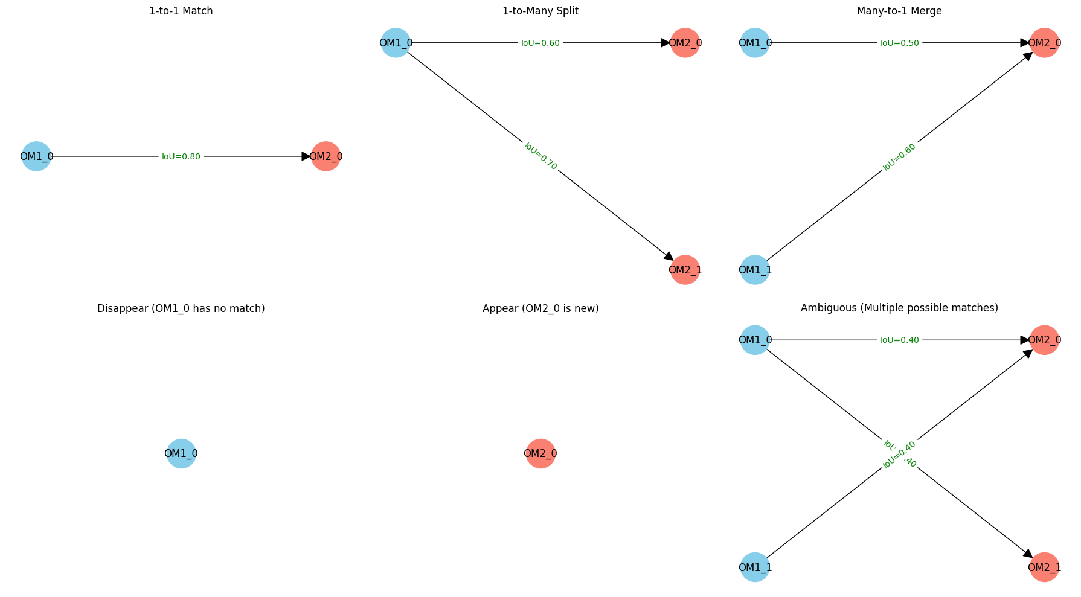

Slide 8
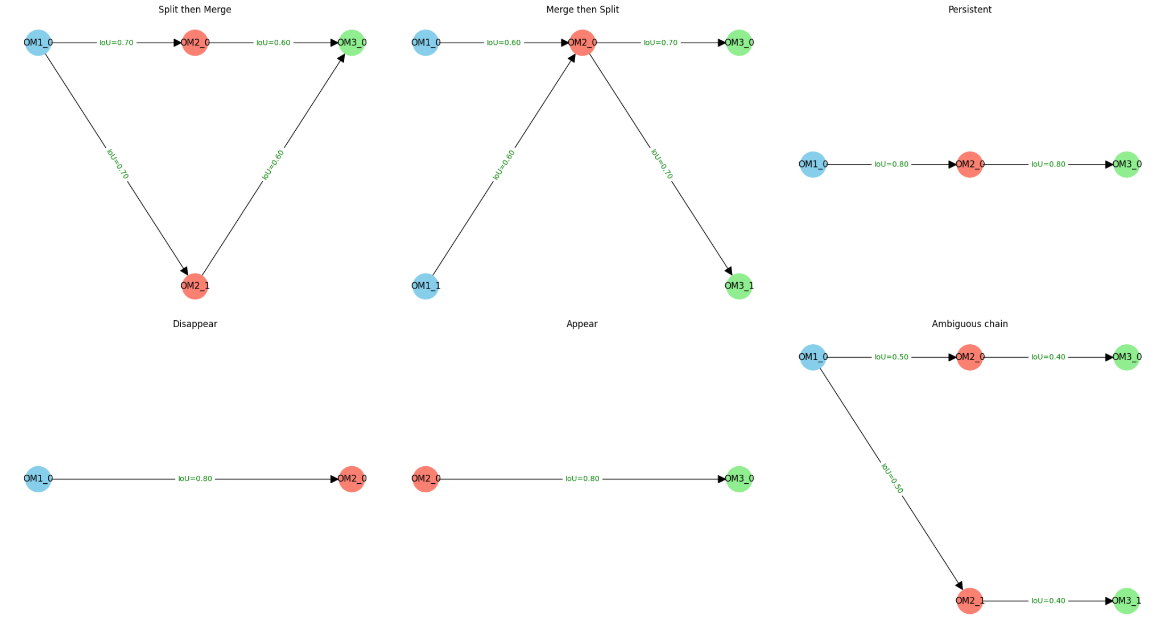

Slide 9
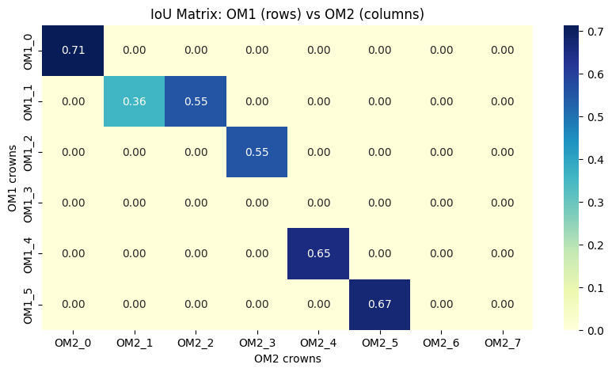
IoU Matrix
Multiple high values in a row or column indicate splits, merges

Slide 10
Back Matching
Current Approach: Only forward edges (e.g., OM1→OM2, OM2→OM3) are allowed, representing temporal progression.
Back Matching: Also allow edges OM2→OM1, OM3→OM2, and even OM3→OM1, OM1→OM3, etc., so any crown can connect to any other.

Slide 11
Should we have edges from OM1 to OM3?
If a crown is missed in OM2 but appears in OM1 and OM3, back matching could help recover the track by linking OM3 directly to OM1.
Cycles in the graph could represent consistent tracks across time
If forward matching is ambiguous, backward edges might help disambiguate
Allowing backward edges can create cycles that violate causality? Multiple cycles may exist for the same object?

